Slide 1
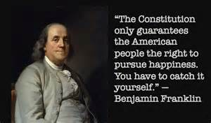
Chapter Six
The Principles of Pleasure
Positive Psychology: The Scientific and Practical Explorations of Human Strengths © 2010 SAGE

Slide 2
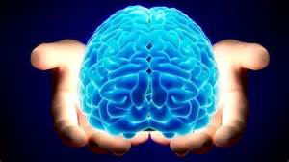
A Question
Would you choose to have your brain treated with a chemical hormone that would make you ecstatically happy all of the time?
Question posed by prominent happiness researcher Ed Deiner
Positive Psychology: The Scientific and Practical Explorations of Human Strengths © 2010 SAGE

Slide 3
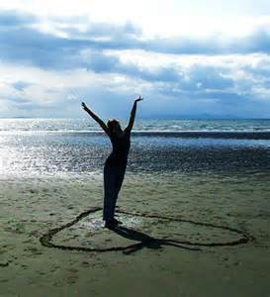
Important Definitions
Affect:
  Immediate, physiological response to a stimulus
  Involves appraisal of event as painful or pleasurable
  A component of emotion
Emotion
  A feeling state resulting from the appraisal of an external object as salient to our own well-being
  A specific quality
  Always has an object
Mood
  Objectless, free floating, and long lasting
Positive Psychology: The Scientific and Practical Explorations of Human Strengths © 2010 SAGE

Slide 4
Important Definitions
Happiness
  Positive emotional state that is subjectively defined
  However, little consensus on its meaning
Subjective Well-Being
  Subjective evaluation of one’s current status in the world
  Often used interchangeably with happiness
  Deiner: it is a combination of positive affect and general life satisfaction
Positive Psychology: The Scientific and Practical Explorations of Human Strengths © 2010 SAGE

Slide 5
The Happiness Advantage
Shawn Achor’s The Happiness Advantage
  Posits that happiness precedes success
  Culture often suggests to us that happiness will occur when we have success, but research suggests the other way around
  The Ted Talk
Positive Psychology: The Scientific and Practical Explorations of Human Strengths © 2010 SAGE

Slide 6
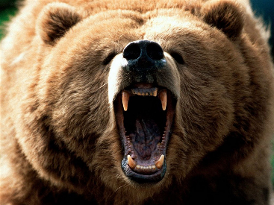
Historical Study of Emotions
More focus on negative emotions
- Negative emotions (e.g., fear, anger) can harm the body but also have survival value (Selye, 1936)
Less focus on positive emotions
- Seen as having hedonic (pleasure-based) value only
Focus has gotten more balanced recently
Positive Psychology: The Scientific and Practical Explorations of Human Strengths © 2010 SAGE

Slide 7
Historical Study of Emotions
Development of the PANAS by Watson & Clark
Measures both Positive and Negative Affect
See page 138
Content of Negative Affect: general distress
Content of Positive Affect: joviality, self-assurance, and attentiveness
Positive and Negative Affect viewed as independent (not polar opposites)
Positive Psychology: The Scientific and Practical Explorations of Human Strengths © 2010 SAGE
Notes:
Make page correction here

Slide 8
PANAS
1 (very slightly 2 (A little) 3 (Moderately) 4 (Quite a bit) 5 (extremely) or not at all)
____ interested
____ distressed
____ excited
____ upset
____ strong
____ guilty
____ scared
____ hostile
____ enthusiastic
____ proud
____ irritable
____ alert
____ ashamed
____ inspired
____ nervous
____ determined
____ attentive
____ jittery
____ active
____ afraid

Slide 9
Positive Affect
Some people have a lot of positive affect
  Feel great much of the time
  Good things bring them pleasure and joy in abundance
Some people have little positive affect
  Don’t feel great
  Don’t jump for joy at success
  Seligman has a friend, Len, who is low in positive affect. But he is happy. So, people can be happy even if they don’t have much positive emotion
Authentic Happiness, Seligman

Slide 10
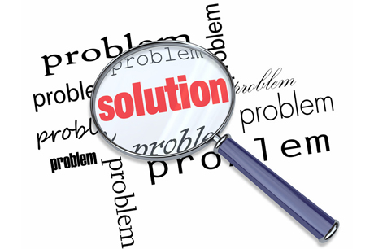
The Study of Positive Emotions
Alice Isen, Cornell University
  When experiencing mild positive emotions, people are more likely to:
- help others
- be flexible in their thinking
- better problem-solve
- more willing to exhibit self-control
Positive Psychology: The Scientific and Practical Explorations of Human Strengths © 2010 SAGE

Slide 11
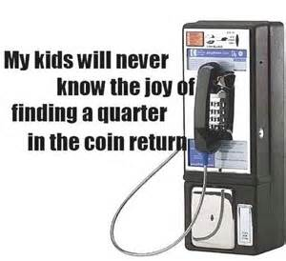
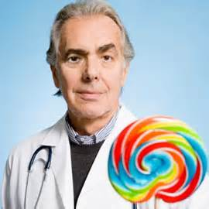
The Study of Positive Emotions
Examples of research:
Coins in pay phones…help others (Isen, 1970)
Candies & physicians (Estrada, Isen, & Young, 1997)
  Superior reasoning and decision making
Positive Psychology: The Scientific and Practical Explorations of Human Strengths © 2010 SAGE

Slide 12
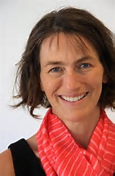
A little about Barbara Fredrickson and the purpose of positive emotion
Won the Templeton Positive Psychology Prize in 2000 ($100,000!) for her theory of the function of positive emotions
Claims positive emotions have a grand purpose in evolution
  Positive emotions broaden intellectual, physical and social resources
  When in a positive mood, people like us better, and friendship, love, and coalitions are more likely to be established
  And, our mental set is expansive, tolerant, and creative; open to new ideas and new experience
Authentic Happiness, Seligman

Slide 13
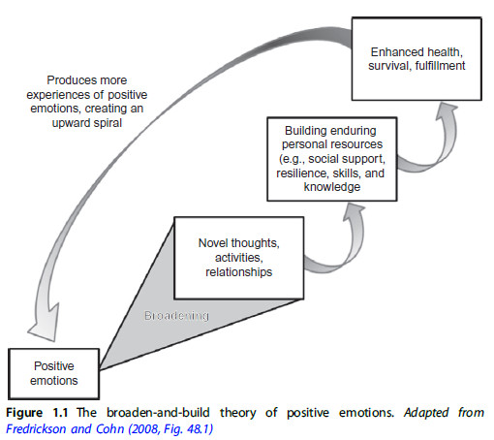
Broaden and Build Theory
Positive Emotions
  Reduce arousal
  Broaden visual focus, thoughts and behavior
Broadening
  Thinking becomes more creative, inclusive, flexible, and integrative
By broadening attention and action, positive emotions can contribute to our creativity, physical health, relationships, and ability to acquire new information, as well as our psychological resilience
Positive Psychology: The Scientific and Practical Explorations of Human Strengths © 2010 SAGE

Slide 14
Broaden-and-Build Model
By Barbara Fredrickson
- based on Isen’s work
Positive Emotions:
- Broaden momentary thought-action repertoires (joy expands what we feel like doing)
- Joy increases likelihood of behaving positively toward others
- Playfulness also being studied (more playful…less stressed, and cope better with stressors; greater life satisfaction)
- Build enduring personal resources including:
        Social, intellectual, physical, & psychological
Positive Psychology: The Scientific and Practical Explorations of Human Strengths © 2010 SAGE

Slide 15
Broaden-and-Build Model
Positive emotions help preserve us by providing nonspecific action tendencies that can lead to new adaptive behavior
  Joy…aimless, unmasked readiness to engage in whatever interaction presents itself
  Adults who feel positive emotions are more likely to interact with others, seek out new experiences, take up creative challenges, and help others in need
Positive emotions also provide spark for changes in cognitive activity that can lead to new and more adaptive thought-action tendencies
  Positive emotions broaden our awareness and then build upon resultant learning to create future emotional and intellectual resources
See Compton and Hoffman

Slide 16
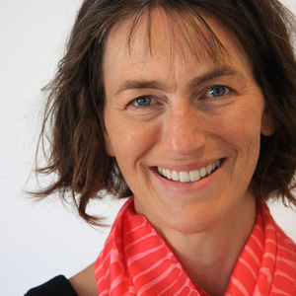
Barbara Fredrickson
The Science of a Meaningful Life
Positive Psychology: The Scientific and Practical Explorations of Human Strengths © 2010 SAGE

Slide 17
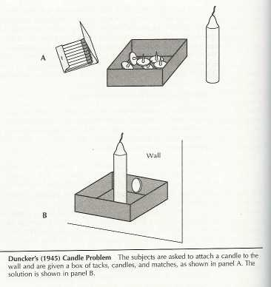
Positive Emotion and Creativity
Candleholder experiment with a twist
Before experiment, made
to feel a positive emotion
Positive emotion induced
makes you more likely to
be creative in completing
task.
SoulPancake

Slide 18
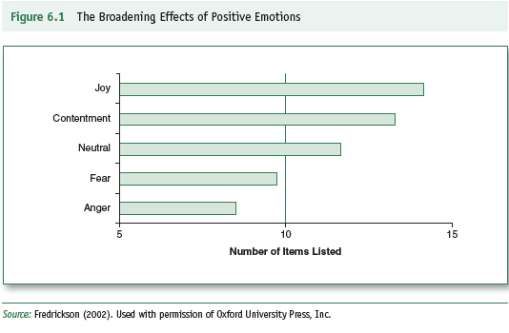
Broaden-and-Build Model
Research Support for Broadening
Participants watched emotion-eliciting film clip and then listed everything they would like to do
Positive Psychology: The Scientific and Practical Explorations of Human Strengths © 2010 SAGE
Notes:
Check figure number here

Slide 19
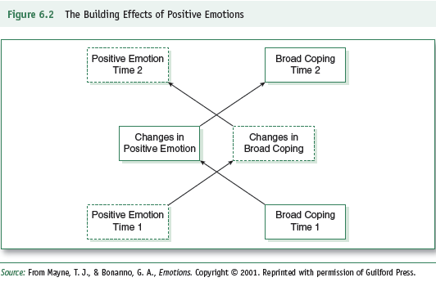
Broaden-and-Build Model
Research Support for Building
  Initial levels of positive emotions predicted overall increases in creative problem solving/coping; these changed in coping also predicted increases in positive emotions. Initial levels coping…increase positive emotion…increase in coping
Positive Psychology: The Scientific and Practical Explorations of Human Strengths © 2010 SAGE
Notes:
Reference page number or figure number here.

Slide 20
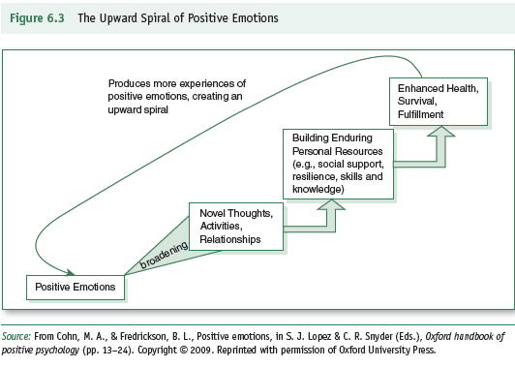
Broaden-and-Build Model
Research Support for Building
Positive Psychology: The Scientific and Practical Explorations of Human Strengths © 2010 SAGE
Notes:
Reference figure number here

Slide 21
The Undoing Hypothesis & Flourishing
Expansions of the broaden-and-build model
Positive emotions as antidotes to negative emotions
  Undoing hypothesis: positive emotions may help the body and mind regain sense of balance, flexibility, and equilibrium (e.g., research of watching a joyful video clip undid effect of the aroused negative emotion)
  Example: when you laugh at yourself following a stressful mistake, you relieve psychological tension and relieve body of stress hormones
Greater number of positives to negatives then tend to flourish
Positive Psychology: The Scientific and Practical Explorations of Human Strengths © 2010 SAGE; see also Compton and Hoffman

Slide 22
Other Research on Positive Affect
Positive affect hypothesized as the cause of success and other beneficial outcomes
  - research evidence is preliminary!
  - need more focus on causation
  (Lyubomirsky, King, & Diener, 2005)
Positive Psychology: The Scientific and Practical Explorations of Human Strengths © 2010 SAGE

Slide 23
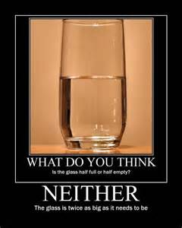
Happy but Dumb? Depressive realism
Depressed people more accurate judges of how much skill they have
Happy people remember more good events than actually happened, and forget more of the bad events
    Depressed people more accurate
    about both
Authentic Happiness, Seligman

Slide 24
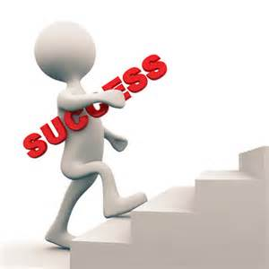
Happy but Dumb? Depressed realism
Success and Failure
  Happy and succeed: they did it, going to last, good at everything
  Happy and failure: you did it to them, it’s temporary, it’s just one little thing
  Depressed are evenhanded in assessing success and failure
Authentic Happiness, Seligman

Slide 25
Depressive Realism…hotly debated
Lisa Aspenwall research (2nd prize winner in Templeton award in 2000)
Research suggests happier people may be better at making important real-life decisions
  Presented participants with scary health-risk information (e.g., link of tanning and melanoma)
  Happy induced or measured through optimism
  Asked one week later what they remember
  Happy remember more of negative info and rated it as more convincing
Authentic Happiness, Seligman

Slide 26
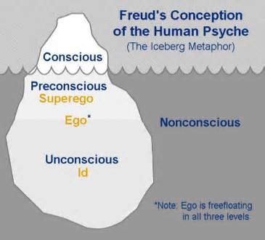
Theories of Happiness
Need/goal satisfaction theories
  Psychoanalytic theory (Freud):
  reduction of tension leads
  to happiness
Positive Psychology: The Scientific and Practical Explorations of Human Strengths © 2010 SAGE

Slide 27
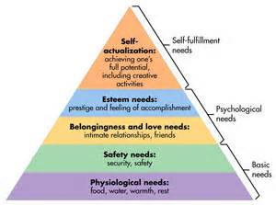
Theories of Happiness
Maslow = satisfaction of needs leads to happiness
Positive Psychology: The Scientific and Practical Explorations of Human Strengths © 2010 SAGE

Slide 28
Theories of Happiness
2) Process/activity theories
  Engaging in particular life activities generates happiness
  Flow: engagement in interesting activities that match or challenge task-related skills
    People who experience flow tend to be very happy
  Types of processes and activities valued and deemed positive may differ among cultural groups (e.g., expressing gratitude increase well-being in US participants and decreased for South Korean)
Positive Psychology: The Scientific and Practical Explorations of Human Strengths © 2010 SAGE

Slide 29
Theories of Happiness: Process/Activity Theories
Engaging in particular life activities = Happiness
Mike Csikszentmihaly
- Flow = engagement in interesting activities that match of challenge one’s skills
- Engagement produces happiness
Positive Psychology: The Scientific and Practical Explorations of Human Strengths © 2010 SAGE

Slide 30
Theories of Happiness: Genetic/Personality Predisposition
Happiness as stable
Personality as the source of happiness
Genetics influence:
-up to 40% of positive emotionality
- up to 55% of negative emotionality
(about 50% not explained via biology)
Positive Psychology: The Scientific and Practical Explorations of Human Strengths © 2010 SAGE

Slide 31
How Happy Are We?
National Opinion Research Center (2000)
  60% of Americans “pretty happy”
  30% of American “very happy”
The Gallup Organization (2010)
  48.4% of Americans said they felt “a lot of happiness and enjoyment without a lot of stress and worry”
See Compton and Hoffman

Slide 32
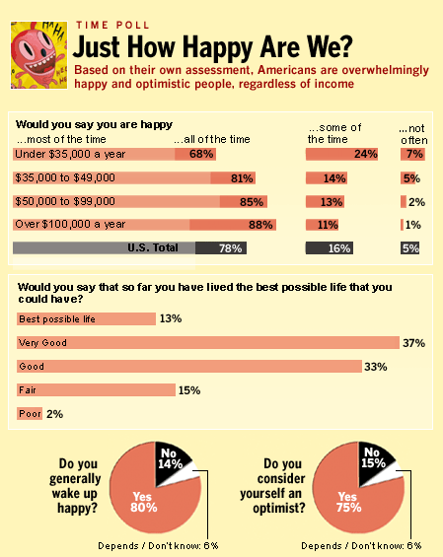
Positive Psychology: The Scientific and Practical Explorations of Human Strengths © 2010 SAGE

Slide 33
Yale and Happiness Course
Lauri Santos interview on CBS Good Morning
https://www.youtube.com/watch?v=vadKibPnTec
Positive Psychology: The Scientific and Practical Explorations of Human Strengths © 2010 SAGE

Slide 34
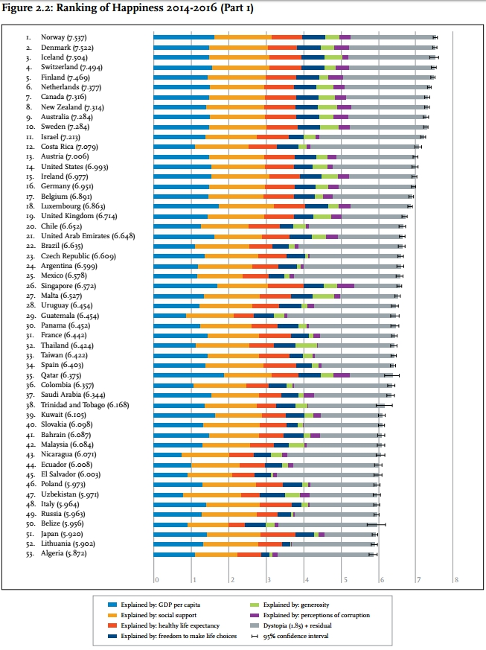
World Happiness Report 2018
Positive Psychology: The Scientific and Practical Explorations of Human Strengths © 2010 SAGE

Slide 35
Why Is Happiness Important?
People who reported they were happy and experienced more positive emotions:
  Had better marriages
  Had more fulfilling friendships and social relationships
  Were healthier
  Were more involved in their communities
  Had better coping skills
  Had more satisfaction with their jobs
  Tended to have higher incomes
Positive Psychology: The Scientific and Practical Explorations of Human Strengths © 2010 SAGE

Slide 36
Subjective Well-Being
Ed Diener
A synonym for happiness
Diener considers well-being to be the subjective evaluation of one’s current status in the world
A combination of positive affect (in the absence of negative affect) and general life satisfaction
Positive Psychology: The Scientific and Practical Explorations of Human Strengths © 2010 SAGE

Slide 37
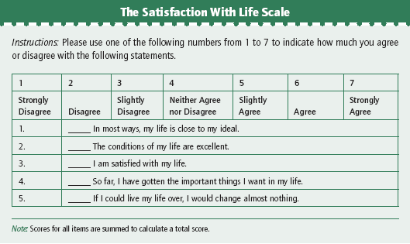
Subjective Well-Being
Positive Psychology: The Scientific and Practical Explorations of Human Strengths © 2010 SAGE
Notes:
Check figure and page number here

Slide 38
Subjective Well-Being
Determinants:
- Financial status…up to a point
- Marriage
Western: married more happy than not married, but link varies with age, income, educational levels, and across racial and ethnic backgrounds
- Social relationships
Research: Happiest 10% of US College students: good mental health and good social relationships
Positive Psychology: The Scientific and Practical Explorations of Human Strengths © 2010 SAGE

Slide 39
Happiness + Meaning = Well-Being
Hedonic perspective: happiness and well-being are synonymous.
Aristotle’s views of eudaimonia: happiness and well-being are not synonymous.
  Well-being = happiness and meaning
  Living a eudaimonic life goes beyond pleasure and embraces “flourishing.”
Positive Psychology: The Scientific and Practical Explorations of Human Strengths © 2010 SAGE

Slide 40
21st Century Models of Happiness
Most Western psychology focus: happiness emphasizes pleasure, satisfaction and life meaning
Happiness literature emphasizes hedonics, meaning, and authenticity
  Seligman: pleasure and meaning via using character strengths; engage our strengths and virtues results in living authentically and tend to be higher in well-being
Lyubomirsky et al:
genetic set point + circumstances + activities
(50%) (10%) (40%)
Positive Psychology: The Scientific and Practical Explorations of Human Strengths © 2010 SAGE

Slide 41
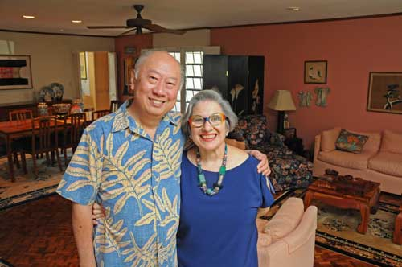
The Happiest American: Alvin Wong
Interview with Alvin Wong
Positive Psychology: The Scientific and Practical Explorations of Human Strengths © 2010 SAGE

Slide 42
Complete State Model of Mental Health
Optimal functioning: High levels of symptoms of emotional, psychological, and social well-being and the absence of recent mental illness
  Emotional=subjective well-being, or presence of positive affect and satisfaction with life, and absence of negative affect
  Social=acceptance, actualization, contribution, coherence, and integration
  Psychological=self-acceptance, personal growth, purpose in life, environmental mastery, autonomy, positive relations with others
Dimensional (extremes of mental health and illness symptomatology are reflected) AND Categorical (because assignment to distinct diagnostic categories is possibilities)
Positive Psychology: The Scientific and Practical Explorations of Human Strengths © 2010 SAGE

Slide 43
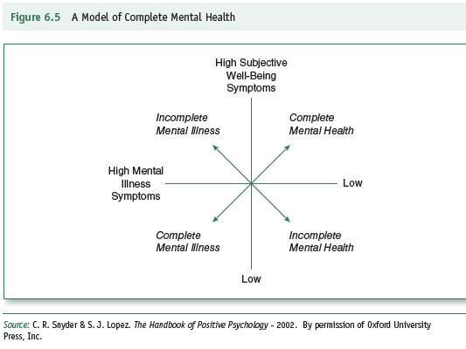
Complete State Model of
Mental Health
Positive Psychology: The Scientific and Practical Explorations of Human Strengths © 2010 SAGE
Notes:
Reference needed here for figure number and page number

Slide 44
Suggestions for a Happier Life
(David Myers)
Ten suggestions:
Realize that enduring happiness doesn’t come from success.
Take control of your time.
Act happy.
Seek work and leisure that engages your skills.
Join the “movement” movement (aerobic exercise).
Give your body the sleep it wants.
Give priority to close relationships.
Focus beyond the self—reach out to those in need.
Keep a gratitude journal.
Nurture your spiritual self.
2 Minutes with Barbara Fredrickson
Positive Psychology: The Scientific and Practical Explorations of Human Strengths © 2010 SAGE

Slide 45
Life enhancement strategies
Love: be kind to others, express your love.
Work: be positive, generate interactions.
Play: help others play, use relaxation.
Positive Psychology: The Scientific and Practical Explorations of Human Strengths © 2010 SAGE

Slide 46
Mini-Experiments
In Search of Joy and Lasting Happiness
1. Cartoon/Comedy Pretest-Posttest
2. The “Movie, Then What?” Experiment
3. Commonsense Definitions of Happiness
“How do you define happiness in your life?”
“What are some signs of your happiness?”
Positive Psychology: The Scientific and Practical Explorations of Human Strengths © 2010 SAGE

